Slide 1
CONTENTS
INTRODUCTION
EXISTING SYSTEM
PROPOSED SYSTEM

Slide 2
EXISTING SYSTEM
All work done manually.
In Manual booking system customer has to go the travelling office.
Ask inquiry for travelling then book ticket ,finally pay payment and collect reciept.
Difficult to maintain the customer details of package and payment receipt in register.
In existing system, they register your package in the notebook.

Slide 3
PROPOSED SYSTEM
To provide search facility for customer.
To provide the online ticket bookimg and online payment facility for customer.
To provide package details.
Customer can cancel the booking
By using this portal the user can book any travel packages, they can reserve their tickets for any travel through online.

Slide 4
Facilities provided by the ‘Tour Around’ portal:
Holiday Packages.
Travelling.
Railway Travel.
Cruise Travel.
Flight Travel.
Car Travel.
Currency converter.
Distance calculator.
Hotel Reservation.
List of hotels in India.

Slide 5
Software Requirement Specification (SRS)

Slide 6
Functional specification
This application consits following modules:
User Module
Distance Calculator
Currency Converter

Slide 7
USER MODULE
If any user wants to use the facilities which are provided in this portal he/she must be register in Tour Around portal by using username and password they can login and they can use all the facilities.

Slide 8
Distance Calculator
Distance calculator gives the distance between source and destination cities. It gives idea to the customers to choose the vehicle to do journey based on their budget.
Facilitated Vehicles are:
Flight Travel.
Railway Travel.
Cruiser Travel.
Car Travel.

Slide 9
Currency converter
It helps the visitors who comes from foreign .
If foreigners have no idea about the value of their currency in indian rupee then they can use currency converter.

Slide 10
SOFTWARE REQUIREMENTS
Operating System : Windows
Front end :
Backend : Oracle 10g
Technology : Java/j2ee (JDBC, Servlets, JSP)
Web Technologies : Html, JavaScript, CSS
Web Server : Apache Tomcat 7
Database : Oracle
Software’s : J2SDK1.5, Tomcat 5.5

Slide 11
HARDWARE REQUIREMENTS
Hardware : Pentium based systems with a minimum of P4
RAM : 4.00GB
Hard Disk :
Additional Tools:
HTML Designing : Dream weaver Tool
Development Tool kit : My Eclipse

Slide 12
User characteristics
Types Of Users:
Internal users: Internal users are people who shall register to use “Tour Around” portal.
External users: External users are people who have not got any user account for the “Tour Around” portal.

Slide 13
FUNCTIONAL REQUIREMENTS

Slide 14
SPECIFIC REQUIREMENTS
FUNCTIONAL REQUIREMENTS
NON –FUNCTIONAL REQUIREMENTS

Slide 15
USE CASE DIAGRAM
Use case diagrams are employed in UML (Unified Modeling Language), a standard notation for the modeling of real-world objects
A use case diagram is a graphic depiction of the interactions among the elements of a system

Slide 16
USE CASE DIAGRAM OF REGISTERED CUSTOMER
Login
Register
TrainBooking
CarBooking
CruiseBooking
HotelBooking
RegisteredCustomer
Insurance
Logout
Cancel Reservation
Retrieves Information

Slide 17
USE CASE DIAGRAM OF GUEST CUSTOMER
Distance Calculator
Currency Conversion
View
Services
HolidayTours
GUEST CUSTOMER
Vehicals
Guest House

Slide 18
Non Functional (Software System Attributes)
Security
The web server and database server should be protected from hacking, virus etc.
Portability
The application will be developed using standard open source software (Except Oracle) like Java, tomcat web server, Internet Explorer Browser etc these software will work both on Windows and Linux o/s. Hence portability problems will not arise.

Slide 19
Maintainability
The system called the e-wheels uses the 2-tier architecture. The 1st tier is the GUI, which is said to be front-end and the 2nd tier is the database, which uses Oracle 10g, which is the back-end. The front-end can be run on different systems (clients). The database will be running at the server. Users access these forms by using the user-ids and the passwords.
Reliability
The package wills pick-up current transactions on line. Regarding the old transactions, User will enter them in to the system.
Availability
This software will be available always.

Slide 20
Software Design Specification (SDS)

Slide 21
INTRODUCTION
The aim of the SDS is to provide an overview of the entire design document. This document describes all data, architecture, interface and component level design for the software.
PURPOSE
Purpose of this SDS document is to provide a full description of the main objectives.
Focuses on specifying a high level view of the architecture of our system and on the interaction between the user and the system.

Slide 22
Scope
User must have a valid User Id and password to login the system.
Registration for membership and then book the tickets and guest house .
User can view the details regarding any holiday tour.
Visitors are classified to guests and registered users.
Registered members are allowed to book tickets and hotels.

Slide 23
SYSTEM ARCHITECTURAL DESIGN ACTIVITY DIAGRAM
Activity diagram is important diagram in UML to describe the dynamic aspects of the system. Activity diagram is basically a flowchart to represent the flow from one activity to another activity.

Slide 24
Registered User:
Enter in website using portal name
Enter the login details
Check whether login details valid?
No
Yes
Can book the tickets and guest house and cancel tickets also

Slide 25
Guest User:
Enter the website of Tour Around
View the services as guest house list, distance calculator etc provided by this portal

Slide 26
Data Design
Database Design
This include table of each entity.
These tables consist of fields, their descriptions and data type.

Slide 28
SEQUENCE DIAGRAM
A Sequence diagram is another important diagram in UML is a kind of interaction diagram that show how processes operate with one another and what other.

Slide 29
Registered User
Customer
Register
Login
Booking
Cancel
Information
Register
Valid
Success
Request
Valid
Success/Cancel
Booking
Available
Successfull Booking
Cancellation Approach
Successfull cancelled
Possible
Final information generated

Slide 30
USER INTERFACE DESIGN
Home Page
Enroll Today Page
Login Customer
Holiday Tour
Distance Calculator
Currency Conversion

Slide 31
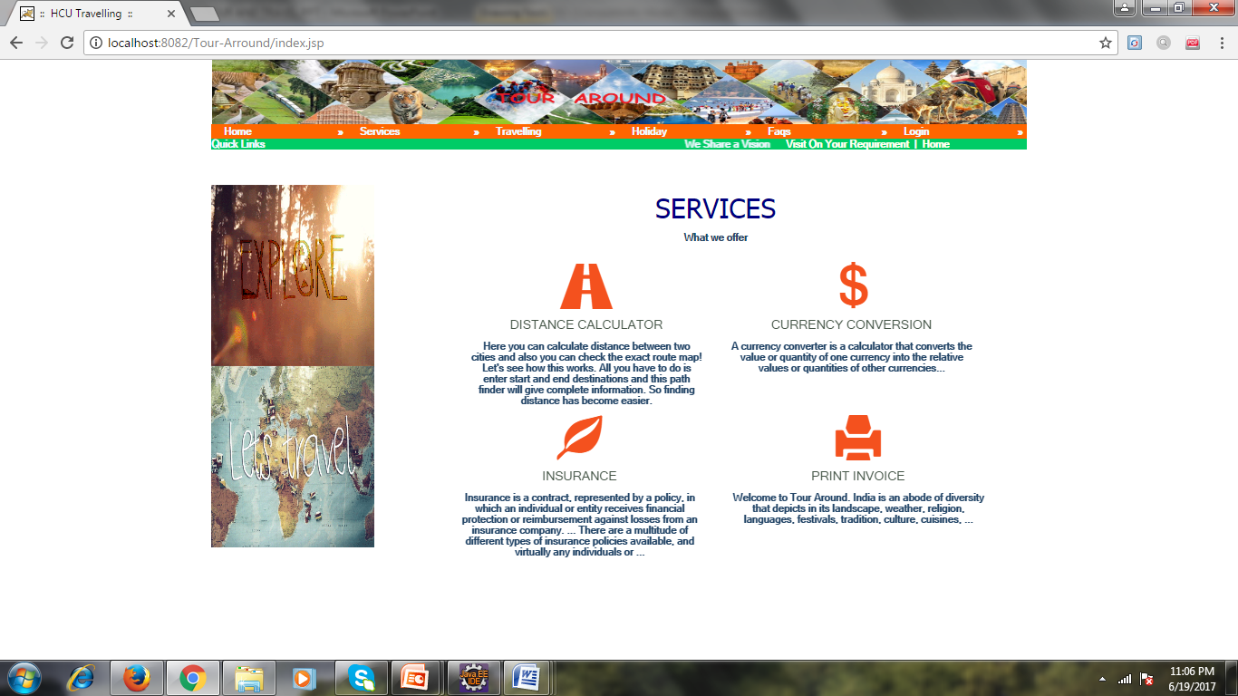
Home Page:

Slide 32
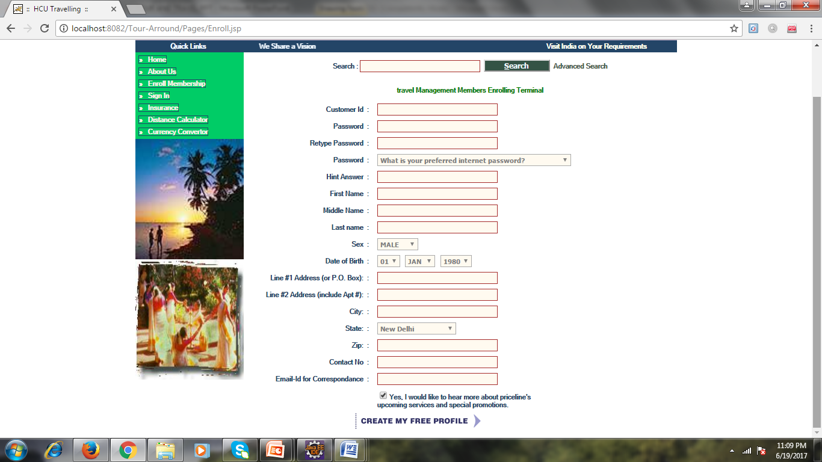
Enroll Today Page:

Slide 33
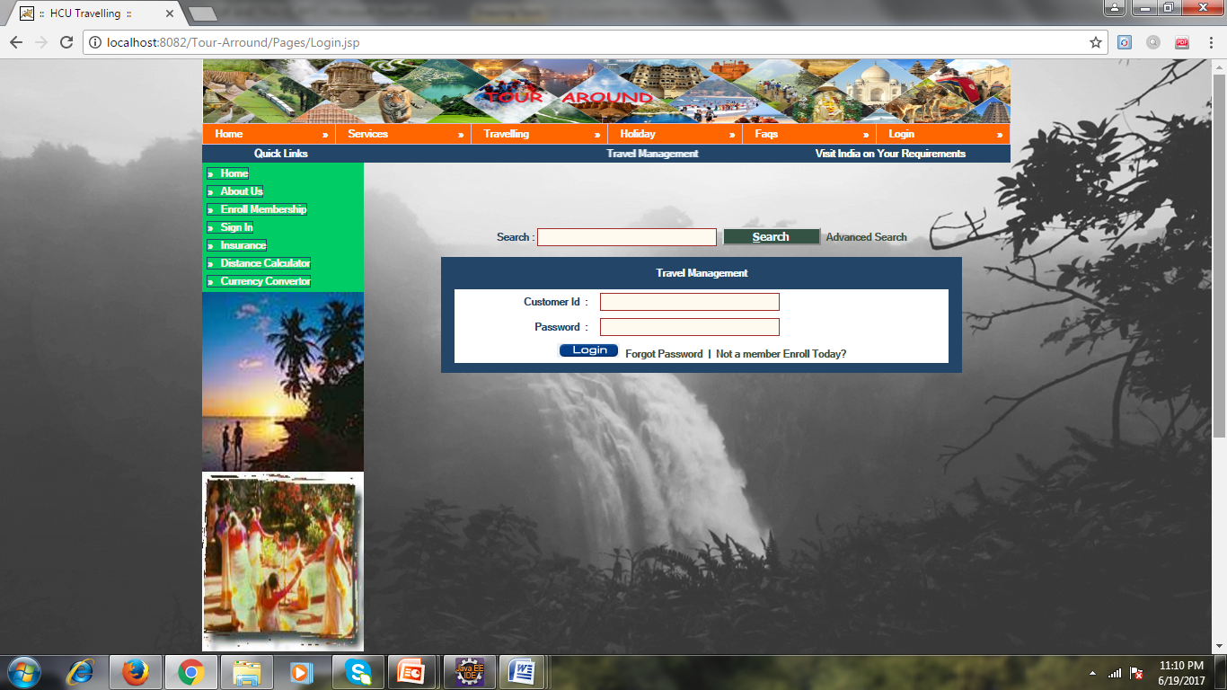
Login Page:

Slide 34
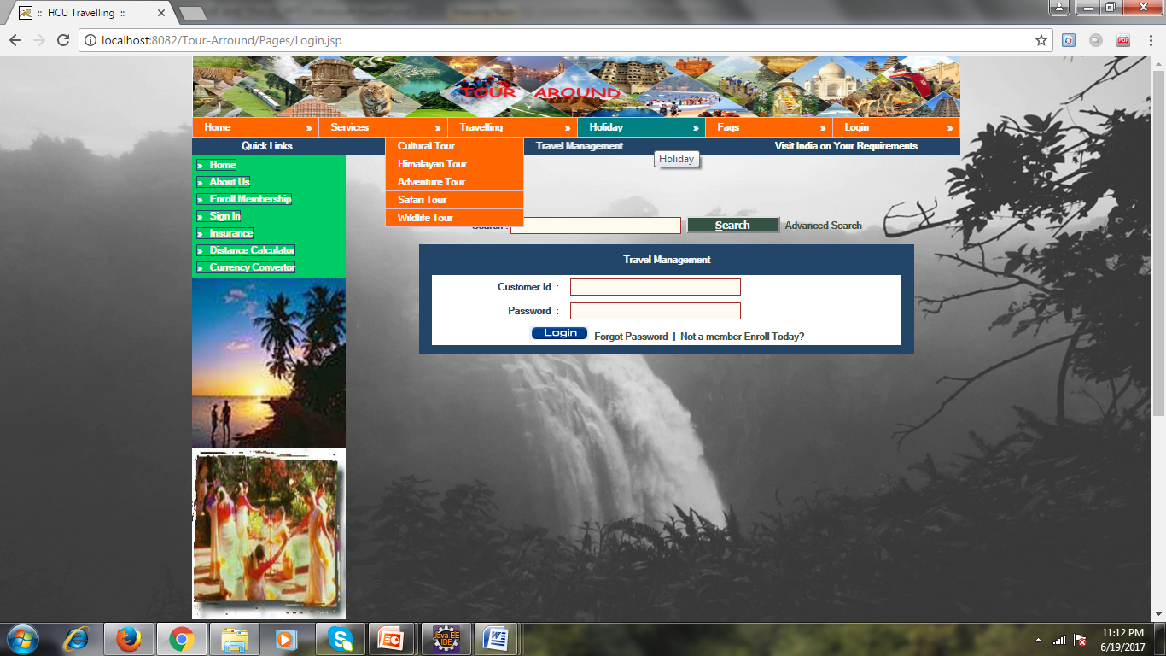
Holiday:

Slide 35
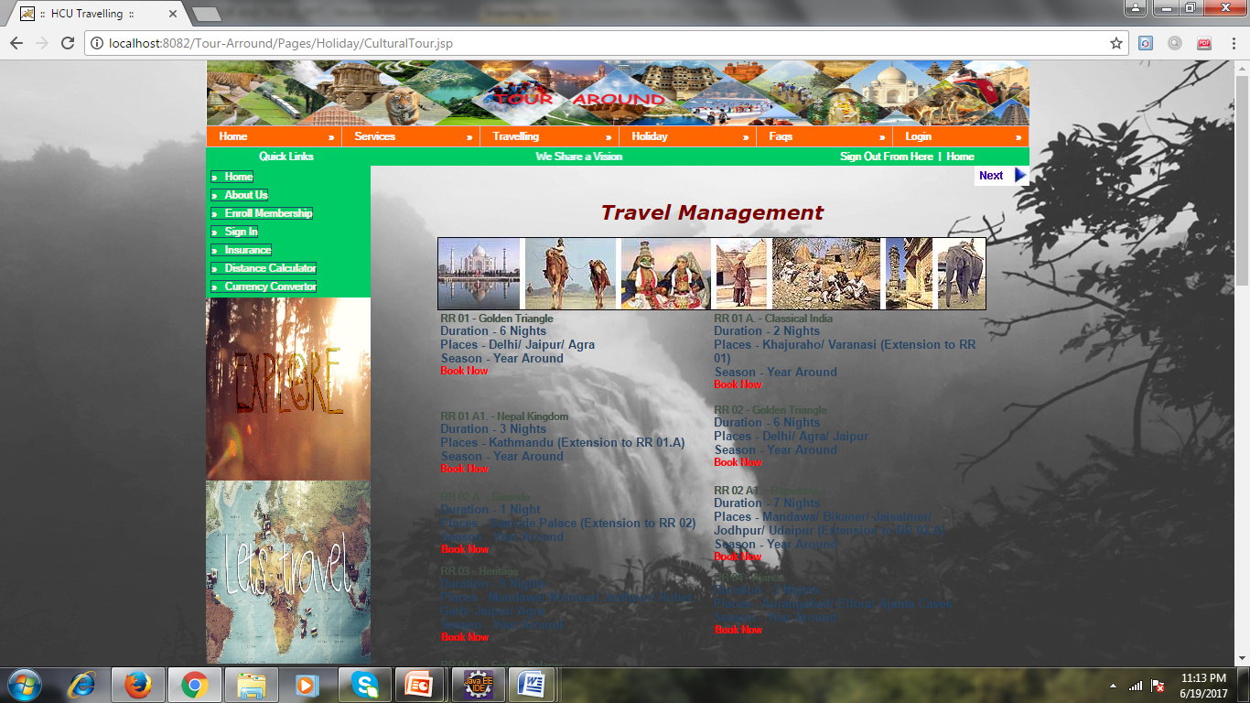
Cultural Tour:

Slide 36
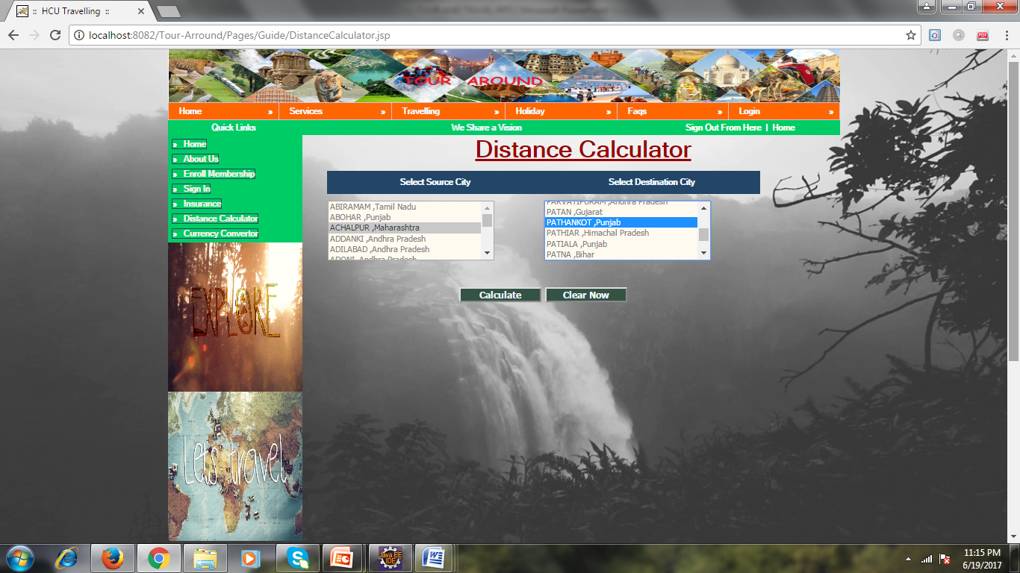
Distance Calculator:

Slide 37
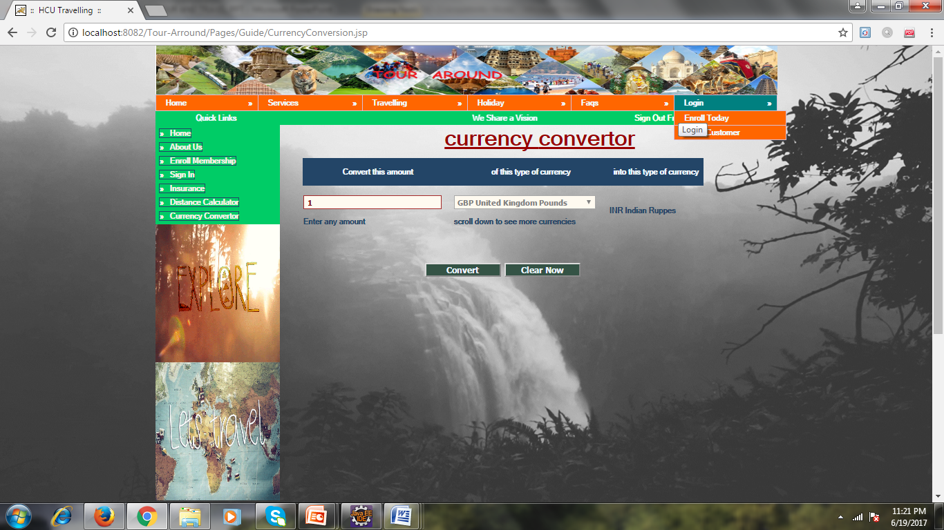
Currency Calculator:

Slide 38
CONCLUSION
Fast processing and immediate results
Minimizing human effort and cost effective database

Slide 39
FUTURE SCOPE AND EVALUATION
Any tourist can make use of it for saving customer details in database.
Tourism group canuse it for managing their locations,hotels and vehicals details.
We can add new features as when we require.
Reusability of this application is also possible.

